Slide 1

Differences of Amenities between High Income vs Low Income in Lubbock
Stan L.

Slide 2
Common Venues in Lubbock
Increased complaints from East Lubbock residents has led to frustration with local government officials
There is value in looking at what’s currently available to residents based on income level
Understanding these differences will help government officials make better policy desicions

Slide 3
Data acquisition and cleaning
Neighborhood Income Median from US Census Bureau
GPS Coordinates for each neighborhood from Google Maps
Using those GPS coordinates we use the Four Square API to see what is within radius

Slide 4
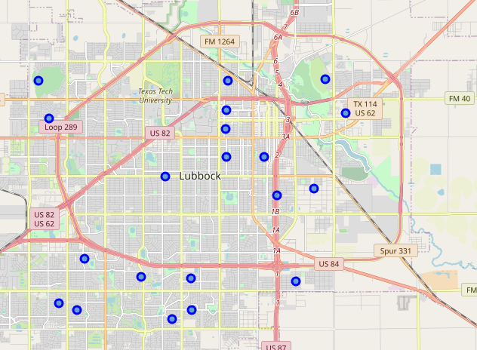
Lubbock Neighborhoods

Slide 5
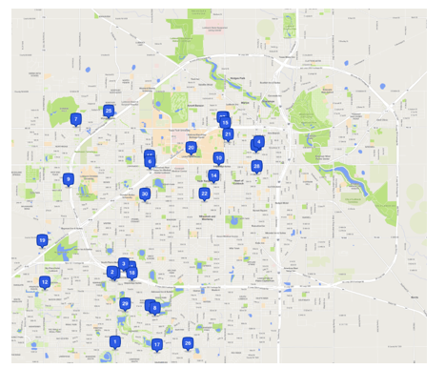
Four Square Venues

Slide 6
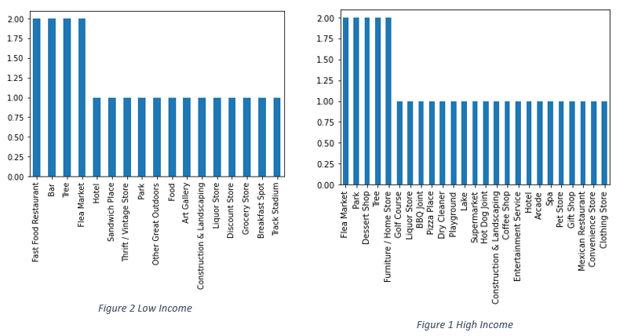
Results

Slide 7
Discussion
Fast Food and Bars are most common in the Low Income Areas
Parks, Dessert Shops, and Furniture Stores are most common in High Income Areas
Flea Markets were common among both income levels within the Lubbock Area
Low confidence in results due to limited Four Square use within Lubbock, especially East Lubbock.

Slide 8
Conclusion
Government Officials should look further into why there is such a discrepancy in available venues in East Lubbock
Four Square and local restaurants should be encouraged to add more data within the Lubbock area so users are aware of other choices they have.
Rezoning could be beneficial in areas that had 0 available venues in the area

